Slide 1
Chapter 8
Biopsychology of Motivation

Slide 2
Motivation and incentives
Motivation – factors within and outside an organism that cause it to behave a certain way at a certain time
Motivational state or drive – an internal condition, which can change over time, that orients an individual to a specific set of goals (e.g. hunger, thirst, sex, curiosity)
Incentives – goals or reinforcers in the external environment (e.g. good grades, food, a mate)
Notes:
Keywords: motivation, motivational state, drive, incentive

Slide 3
Drives as tissue needs
Homeostasis – the constancy of internal conditions that the body must actively maintain
Drives may be an upset in homeostasis, inducing behaviour to correct the imbalance
Animals do behave in accordance with their tissue needs (e.g. increasing or decreasing caloric intake, drive for salt)
However, homeostasis cannot explain all drives
Notes:
Keywords: homeostasis

Slide 4
Types of drive
Regulatory drives – helps preserve homeostasis (e.g. hunger, thirst, oxygen)
Non-regulatory drives – serve other purposes (e.g. sex, achievement)
Notes:
Keywords: regulatory drives, nonregulatory drives

Slide 5
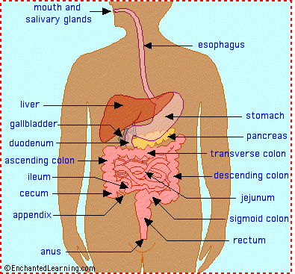
The digestive process
3 nutritional substances: carbohydrate, fat & protein
Made into bolus
Breakdown by enzymes
Absorption in small intestine
Excretion

Slide 6
Eating
Glucose is absorbed by the duodenum
Blood glucose level rises
Triggers the pancreas to release the hormone insulin
Insulin boosts the glucose uptake from the blood into the liver
Where the glucose is not required for immediate energy, it is converted into glycogen and stored
This can later on be converted back into glucose, as needed
Any excess glucose (fat) is stored in adipose tissue

Slide 7
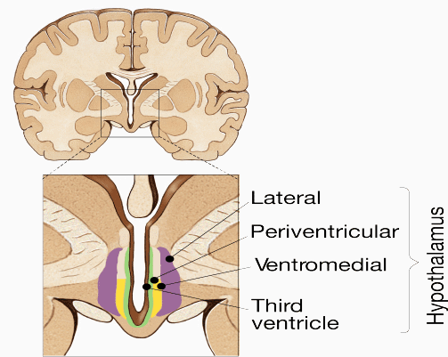
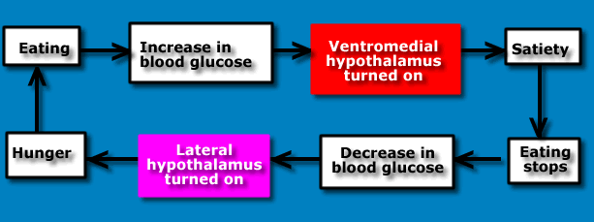
The role of the hypothalamus in hunger and satiety
Lateral hypothalamus initiates eating
LH-lesion syndrome
Aphagia – lack of eating
Adipsia – lack of drinking
Ventromedial hypothalamus – suppression of eating
VMH-lesion syndrome
Hyperphagia – obesity due to overeating

Slide 8
The role of the hypothalamus in hunger and satiety
Arcuate nucleus travels to the paraventricular nucleus of the hypothalamus
The paraventricular nucleus is a part of the hypothalamus that inhibits the lateral hypothalamus which is vital for feelings of hunger and satiety
Axons from the satiety-sensitive cells of the arcuate nucleus deliver an excitatory message to the paraventricular nucleus which triggers satiety

Slide 9
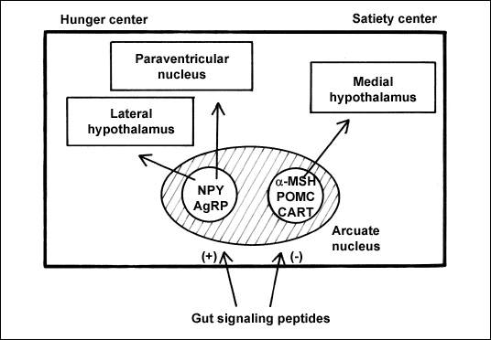
The role of the hypothalamus in hunger and satiety
Input from the hunger-sensitive neurons of the arcuate nucleus is inhibitory to:
The paraventricular nucleus and
The satiety-sensitive cells of the arcuate nucleus itself
inhibitory transmitters include
GABA
neuropeptide Y (NPY)
agouti-related peptide (AgRP)
Neuropeptide Y (NPY) and agouti-related peptide (AgRP) are inhibitory and block the satiety action of the paraventricular nucleus and encourage overeating

Slide 10
The role of the hypothalamus in hunger and satiety
Paraventricular nucleus acts on the lateral hypothalamus
The lateral hypothalamus controls insulin secretion and alters taste responsiveness
Animals with damage to this area refuse food and water and may starve to death unless force-fed

Slide 11
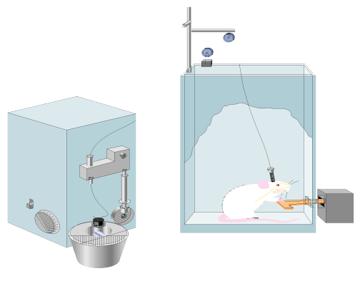
Non-neural control of eating behaviour
Peripheral cues
Oral cues – taste
Stomach cues – distention cue for termination

Slide 12
Non-neural control of eating behaviour
Hormonal satiety cues
Cholecystokinin (CCK) – neuropeptide hormone produce satiety
Glucostatic principle – blood sugar level important
Glucoreceptors in liver & hindbrain detect low blood sugar level
Pancreas releases insulin
Lipostatic theory – metabolize fatty acids
Ghrelin
A hormone produced mainly by P/D1 cells lining the fundus of the human stomach
Ghrelin levels increase before meals and decrease after meals

Slide 13
Environmental factors of eating
Hunger cannot, in reality, be understood with just the biological component
Individuals (whether or not they are obese) react to external cues
Time
Likes/dislikes

Slide 14
Obesity & long-term control of body weight
Obesity is defined as BMI of 30 or greater
The Lipostatic theory – fat metabolism circulating in the blood acts as a signal to the hypothalamus
Hormone leptin is concerned with long-term weight control – feedback loop
High leptin indicates sufficient energy reserves and low amounts indicate hunger mode
Leptin also
minimizes the impact of NPY
promotes alpha-melanocyte-stimulating hormone (a-MSH) which also reduces appetite
increase the effects of appetite suppressants like cocaine-amphetamine-regulated transcript (CART), bombesin and corticotropin-releasing factor (CRF)
Obese people in general have a resistance to these high levels of leptin

Slide 15
Set point theory
We have a set weight, determined by the hypothalamus that the body tries to maintain (Keesey & Powley, 1986)
Body itself works to maintain that set point
Damage to the VHM might raise the critical set point

Slide 16
Genetics and overweight
Leptin, the protein hormone encoded by the ob gene
Mice with mutations on both ob genes (ob/ob mice) are unable to synthesize leptin
Lack of leptin results in overactive neuropeptide Y neurons and hyperphagia and obesity, which mirrors VMH or PVN damage
Genetic mutations that cause defects in the leptin synthesis and lepin receptors give rise to db/db mice
In fa/fa Zucker rats that have defective leptin receptors lepin has little influence on food consumption
It is quite unusual to find a double mutation for the leptin or leptin receptor genes in humans

Slide 17
Eating disorders
Anorexia nervosa
Severely underweight, and have a distorted body image and an obsessive fear of putting on weight
Mortality rate varies – 5–20% of individuals with this disorder die from starvation or medical complications
Bulimia nervosa
Refers to binge eating followed by compensatory behaviour such as self-induced vomiting, fasting or excessive exercise
90% of those diagnosed with bulimia nervosa are women, and most report that the illness began somewhere between the ages of 12 and 25
People suffering from the disorder secrete abnormally low levels of Cholecystokinin (CCK)

Slide 18
Thirst
Water constitutes 70% of the mammalian body
Water in the body must be regulated within narrow limits
The concentrations of chemicals in water determines the rate of all chemical reactions in the body

Slide 19
Drinking-dry mouth theory
In 1934, Walter Cannon suggested that people feel thirsty because their mouths get dry
Recent research contradicts this theory
Where animals can drink but the water does not enter the stomach
Thirst is only temporarily lessened
Must be other factors that are involved in determining how much water we drink

Slide 20
Thirst
Two different kinds of thirst include:
Osmotic thirst – a thirst resulting from eating salty foods
Hypovolemic thirst – a thirst resulting from loss of fluids due to bleeding or sweating

Slide 21
Osmotic thirst
Osmotic thirst occurs because the human body maintains a combined concentration of solutes at a fixed level of .15 M (molar)
Solutes inside and outside a cell produce osmotic pressure – low solute concentration to an area of high solute concentration
Occurs when solutes are more concentrated on one side of the membrane

Slide 22
Osmotic thirst
The brain detects osmotic pressure from:
Receptors around the third ventricle
The OVLT (organum vasculosum laminae terminalis) and the subfornical organ (detect osmotic pressure and salt content)
Receptors in the periphery, including the stomach, which detect high levels of sodium

Slide 23
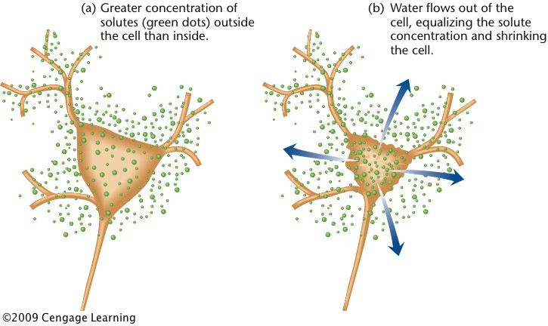
Osmotic thirst
When receptors are stimulated:
The posterior pituitary releases Antidiuretic hormone (ADH) or vasopressin. Vasopressin is a hormone which raises blood pressure by constricting blood vessels to compensate for the decreased water volume
ADH causes kidneys to reabsorb water and excrete highly concentrated urine

Slide 24
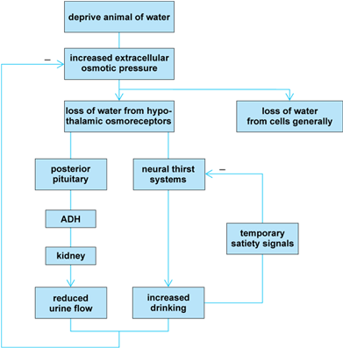
Osmotic thirst

Slide 25
Hypovolemic thirst
Is associated with a low volume of body fluids
Is triggered by the release of the hormones vasopressin and angiotensin II
Angiotensin II formed from angiotensin I by the angiotensin-converting enzyme (ACE).
Angiotensin II constricts the flow of blood, increases the release of ADH
Angiotensin II stimulates neurons in areas adjoining the third ventricle
Triggers the hypothalamus to activate the thirst reflex, resulting in a higher blood pressure

Slide 26
Reproductive behaviour
Two X chromosomes (XX) for females and X and a Y (XY) for males.
Y chromosome in males includes SRY (the sex determining area on the Y chromosome) gene results in the gonads developing into testes – testosterone
A peptide hormone müllerian-inhibiting hormone (MIH) results in the degeneration of the müllerian ducts which, in women, continue to develop into the Fallopian tubes, the uterus and part of the vagina
Research in this area has suggested that testosterone results in the development of the mascularized brain

Slide 27
Early effects of testosterone
Presence of testosterone during critical period will cause rudimentary genitals of fetus to develop into male structures
Testosterone acts in the brain to promote the development of neural systems for male sex drive and inhibit systems for female
Absence of testosterone causes development of female structures
Notes:
Keywords: testosterone

Slide 28
Sex differences in the brain
Sexual responses are associated with the hypothalamus and the limbic system, but no specific ‘sex centre’
Structural differences can be seen in the preoptic regions of the hypothalamus, known as the sexually dimorphic nucleus (SDN)
Males have more SDN than females
The number of cells in the SDN drops significantly in males over the age of 50
One study reported sex differences in the corpus callosum, reporting greater connectivity between the two hemispheres of the brain in women. This was controversial

Slide 29
Role of SDN in sexual behaviour
Male sexual behaviour occurs in two phases:
appetitive stage
consummatory stage
Medial preoptic region of the brain is involved in both stages
Lesions to the SDN-POA cause an extreme disruption to the copulatory activities of rats
Lesions of SDA sexually dimorphic area (SDA) pars compacta in gerbils severely disrupt male copulatory behaviour

Slide 30
Eating

Slide 31
Drinking

Slide 32
Motivation

Slide 33
Readings
Barnes, J. (2011). Essential Biological Psychology (Chapter 8). London: Sage.
The Essentials
Franken, R.E. (2001). Human Motivation (4th edn). Pacific Grove, CA: Brooks/Cole.
Next Steps
Friedman, J.M. (2002). The Function of leptin in nutrition, weight, and physiology. Nutrition Reviews, 60, S1-S14.
Delving Deeper
Bishop, K.M., & Wahlsten, D. (1997). Sex differences in the human corpus callosum: myth or reality? Neuroscience and Biobehavioral Reviews, 21(5), 581-601.

